Slide 1
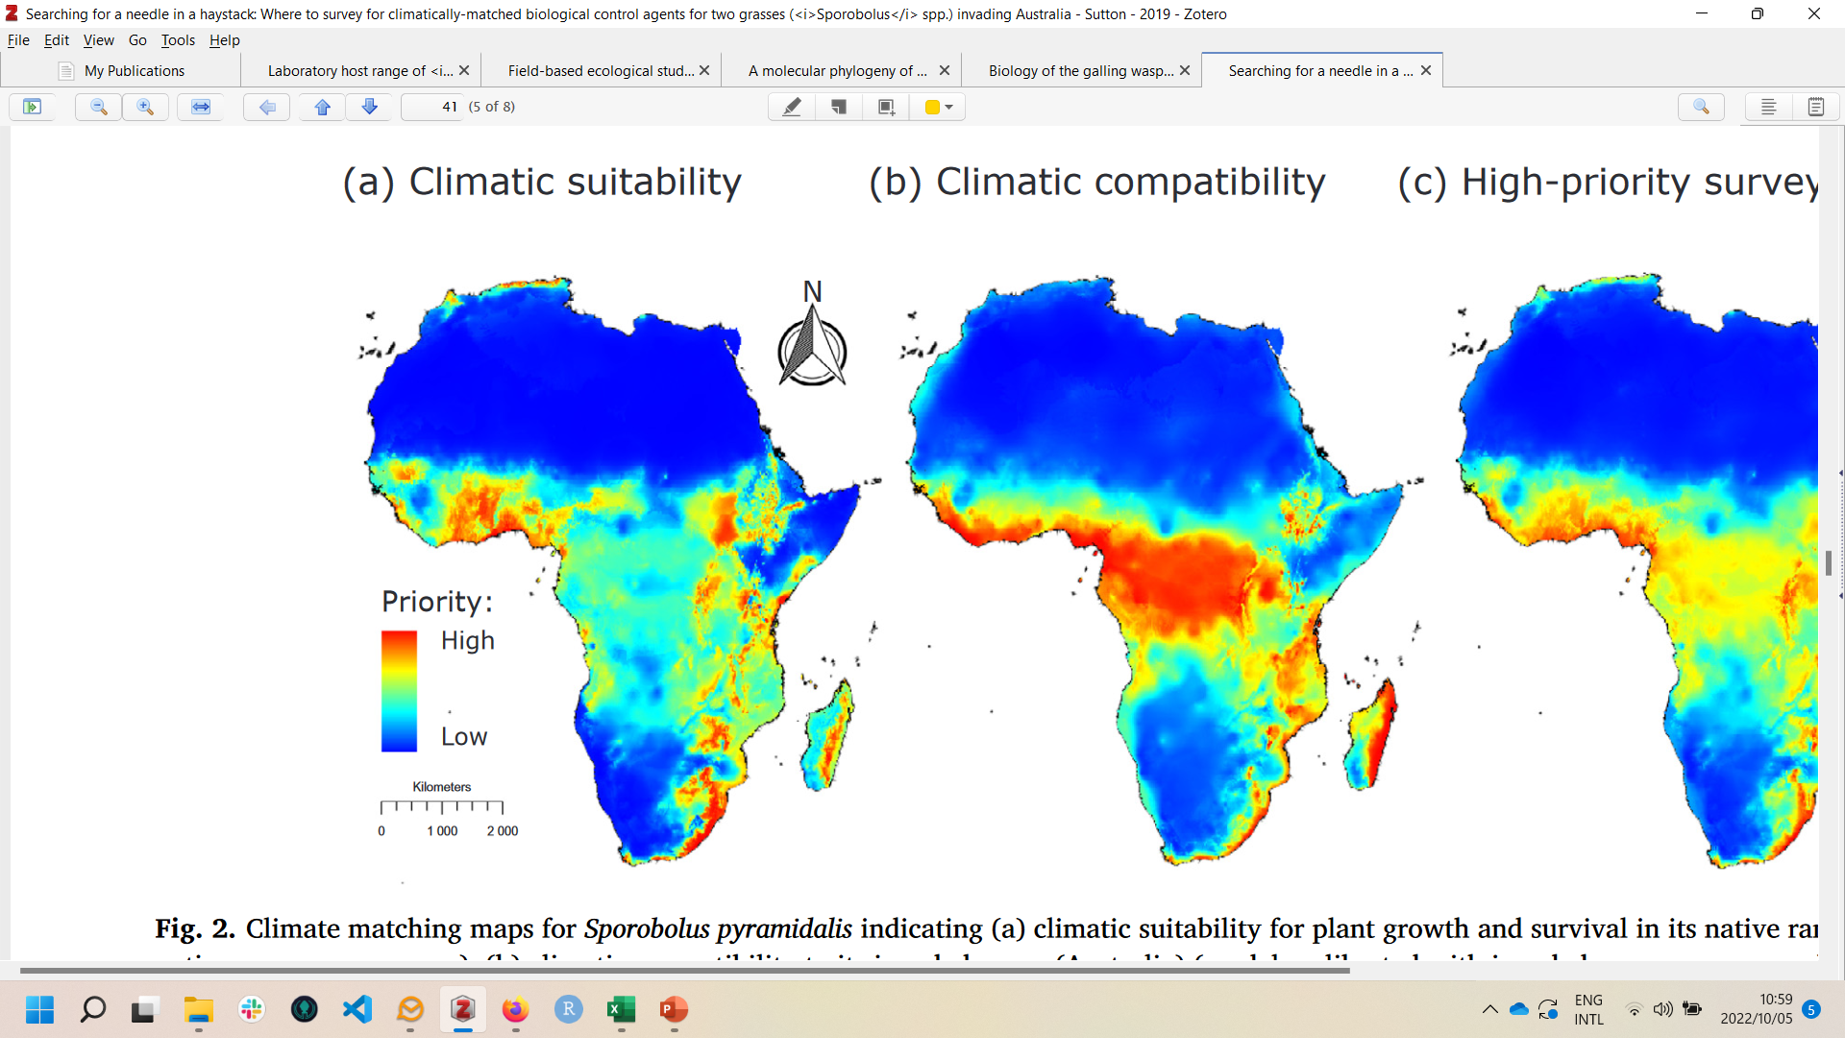










Climate modelling using MaxEnt
Guy F. Sutton
Centre for Biological Control, Rhodes University, Makhanda, South Africa, 6140
Course website: https://github.com/guysutton/2023_maxent_course_cbc

Slide 2
Course Overview – Day 1
Tuesday 21st February 2023:
9am – 10.30am: Introduction to species distribution models (lecture)
11am – 12.30 noon: Climate / topographical data (lecture and R)
2pm – 3.30 pm: Species GPS data (lecture and R)
4pm – 5 pm: Background points (lecture and R)

Slide 3
Course Overview – Day 2
Wednesday 22nd February 2023:
9am – 10.30am: Multicollinearity (lecture and R)
11am – 12.30 noon: Spatial autocorrelation (lecture and R)
2pm – 3.30 pm: Model tuning (lecture and R)
4pm – 5pm: Q/A

Slide 4
Course Overview – Day 3
Thursday 23rd February 2023:
9am – 10.30am: Model fitting (lecture and R)
11am – 12.30 noon: Model evaluation (lecture and R)
2pm – 3.30 pm: Plotting maps (lecture and R)
4pm – 5pm: Q/A

Slide 5
Course outcomes
Understand what SDM’s do and how to use them
Understand the limitations of SDM’s
Run a simple MaxEnt model using R
Interpret the results produced by MaxEnt
Plot a publication-quality map of SDM prediction

Slide 6
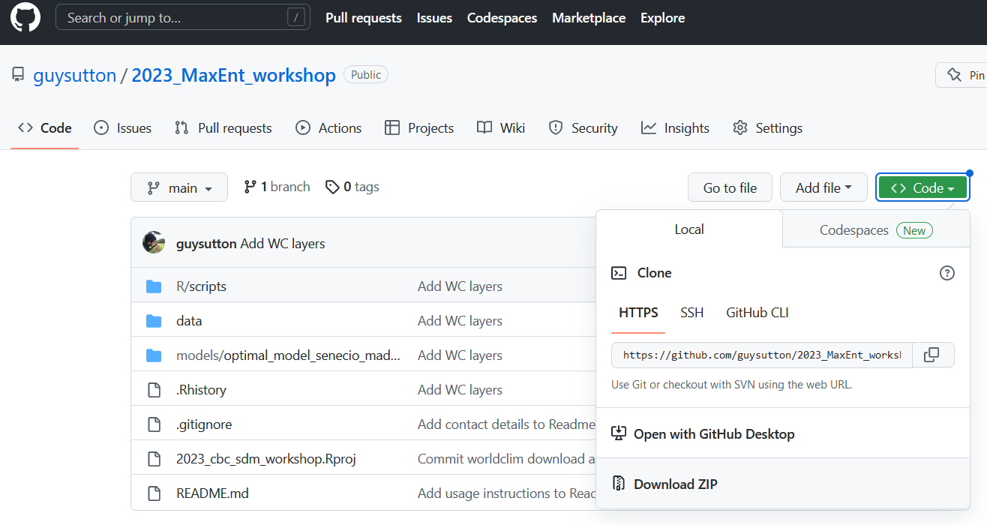
Course materials
All course materials are open-access:
https://github.com/guysutton/2023_maxent_course_cbc

Slide 7
What are SDM’s?
Species distribution models (SDM’s) are important tools in ecology, conservation, phylogeography and invasion biology
Very simply, SDM’s use spatial occurrence data (i.e GPS) with environmental data to predict spatial patterns of environmental suitability for species

Slide 8
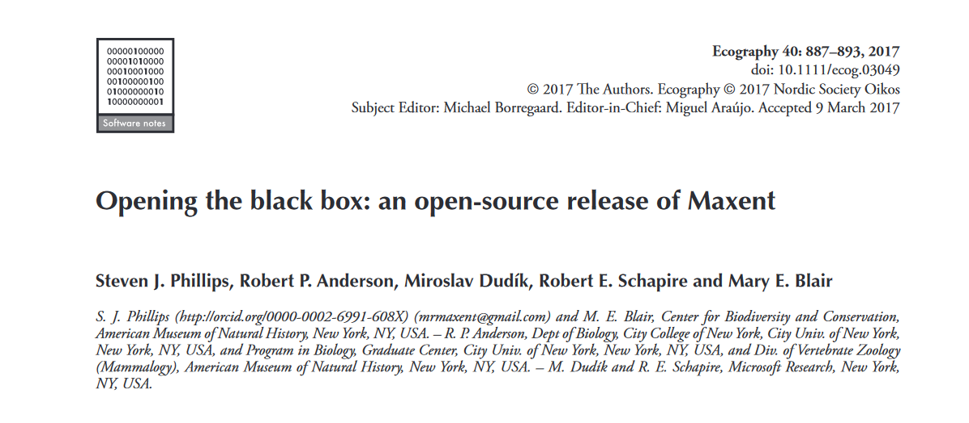
MaxEnt
MaxEnt (Maximum Entropy) is arguably the most popular SDM method (Philips et al., 2017)

Slide 9
How do they work?
Franklin et al. (2009)

Slide 10
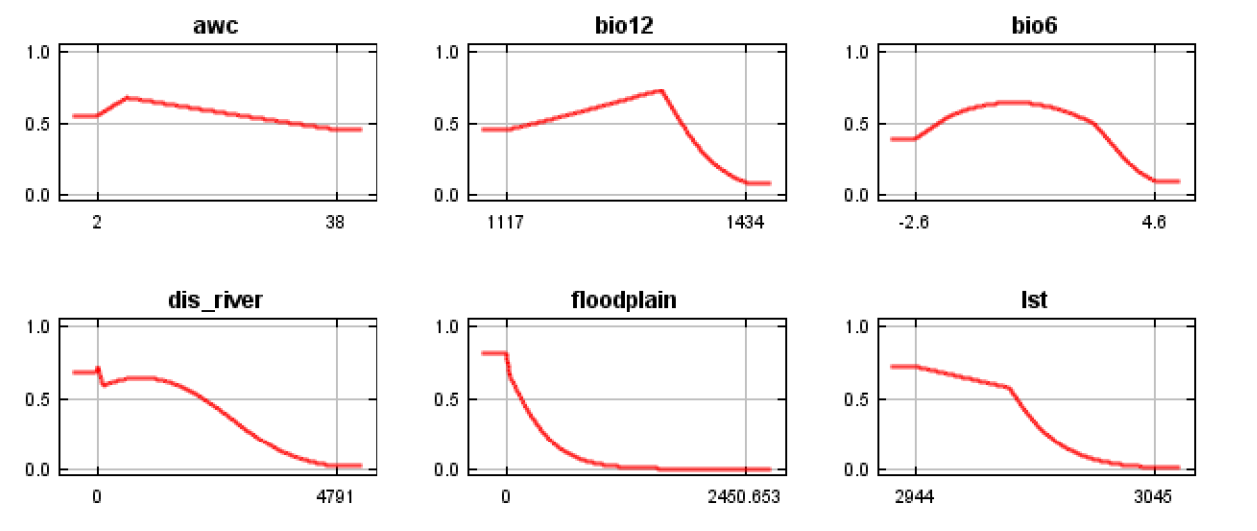
How do they work?
Main assumption:
Species distributions are predictable from environmental variables

Slide 11
What are they used for?
Conservation
Climate change forecasting
Rare species detection
Hypotheses on species distributions
Habitat suitability

Slide 12
Presence-only data
Large databases of presence-only data (e.g. GBIF)
Often display strong biases (e.g. concentrated sampling to major cities, transport routes)
Why is this a problem?

Slide 13
Absence data
Why is absence data important?
Model validation
All SDM’s require information about species presences AND absences
Otherwise it wouldn’t be able to distinguish between suitable and unsuitable areas

Slide 14
Pseudo-absences
To remedy this, most SDM’s use background points or pseudo-absences
We draw random points around the GPS and assume that the species is absent from these sites
Problem, right?
We will discuss this in more detail later…

Slide 15
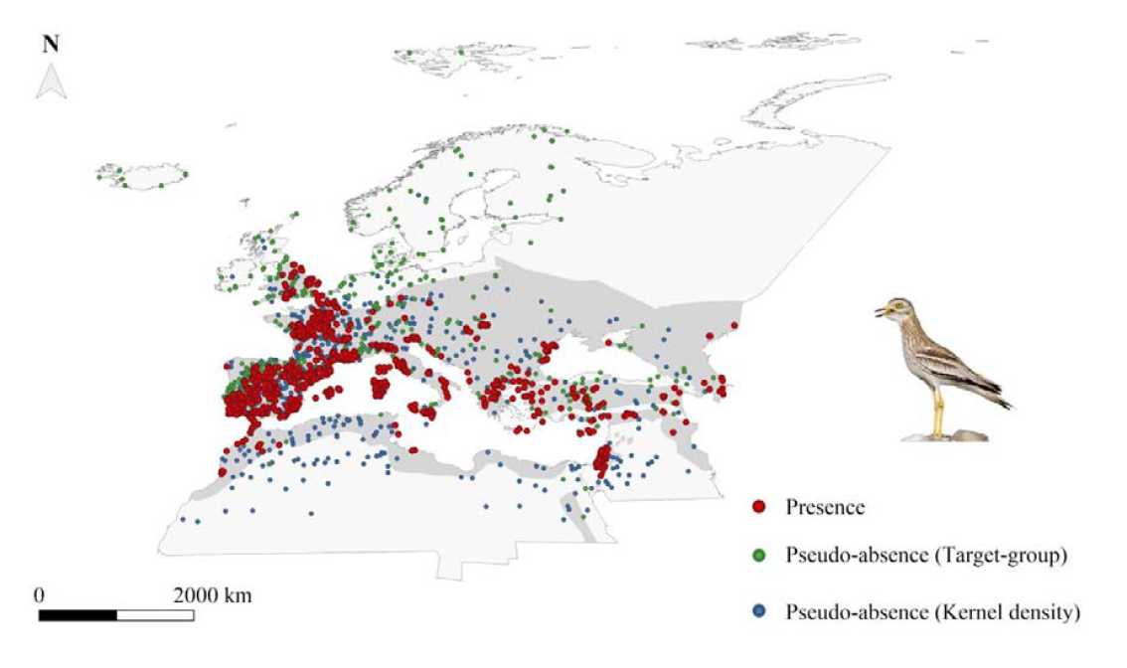
Pseudo-absences
Simoncini et al. 2021 - https://doi.org/10.1101/2021.10.04.462847

Slide 16
How does biocontrol used climate models?
(1) Identify regions in a weeds native range that are climatically similar to the climatic conditions in the weeds invaded range
Areas are given high priority for native-range surveys
Insects/pathogens found in these regions assumed to be climatically suited to invaded range

Slide 17
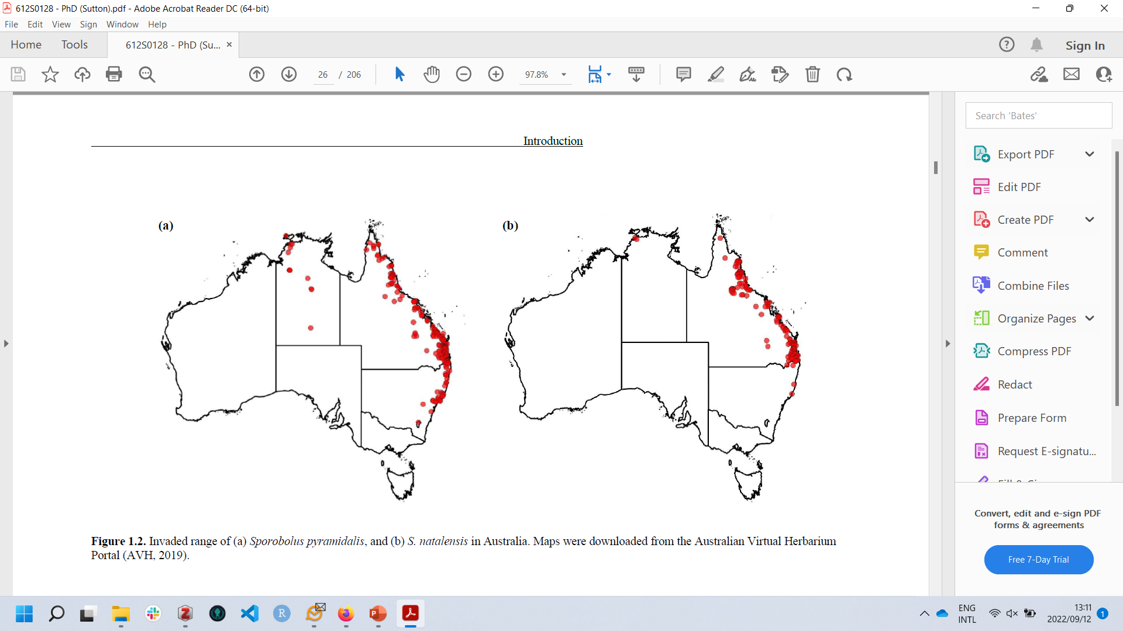
Need: invaded-range weed GPS points + climate data
Identify high-priority regions to survey for biocontrol agents

Slide 18
How does biocontrol used climate models?
(2) Identify regions in a weeds invaded range that are believed to be suitable for a potential biocontrol agent
Used to identify optimal release sites for a novel biocontrol agent, and/or
Prioritise possible biocontrol agents based on their potential to establish viable populations across the weeds invaded distribution

Slide 19
Need: native-range biocontrol agent GPS points + climate data
Identify regions that are climatically suitable for the biocontrol agent – assume increased establishment rates/abundance

Slide 20
But, do climate models work?
To our knowledge, there isn’t any data showing that climate models lead to increased biocontrol agent establishment / abundances…
We have performed a retrospective analysis validating the use of climate modelling for weed biocontrol
Caveat, this is just one case-study… But, the results are promising

Slide 21
How do we know if it works?
If climate matching works, we would expect a positive correlation between climate matching scores (ranging 0 – 1) and insect establishment/abundance
We used Dasineura rubiformis as a case-study. . .

Slide 22
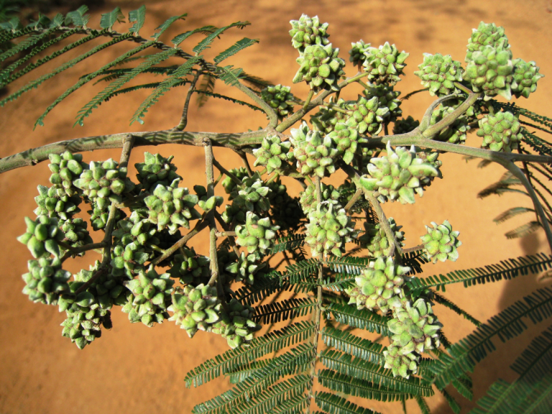
How do we know if it works?
We used Dasineura rubiformis as a case-study. . .
Can we predict establishment in RSA?
Van Wilgen et al. 2020 - https://doi.org/10.1016/j.cois.2019.12.004

Slide 23
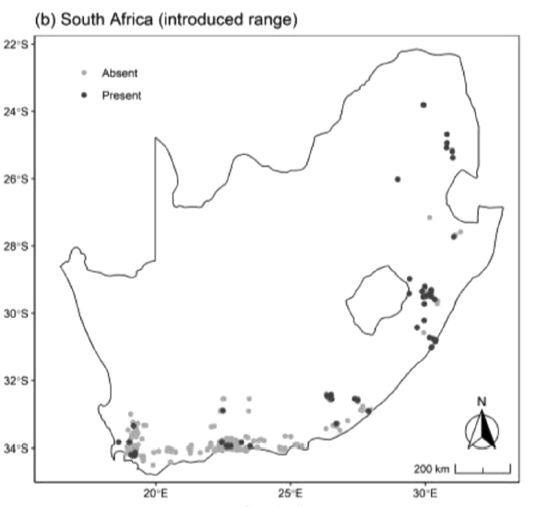
We have native-range data for D. rubiformis
Allows us to predict climatic suitability in weeds invaded range
Extract climatic suitability scores for each site where insect is established and absent, and evaluate if there is a correlation

Slide 24
Results
Strong, positive correlation
As climate suitability scores increase (i.e. climate more similar to native-range), probability of insect being recorded increases

Slide 25
Application
Because we have validated the climate model with establishment data (or abundance data), we can convert climate suitability scores into probability of occurrence/establishment (or estimating abundance)
Useful for developing data-driven mass-release programmes

Slide 26
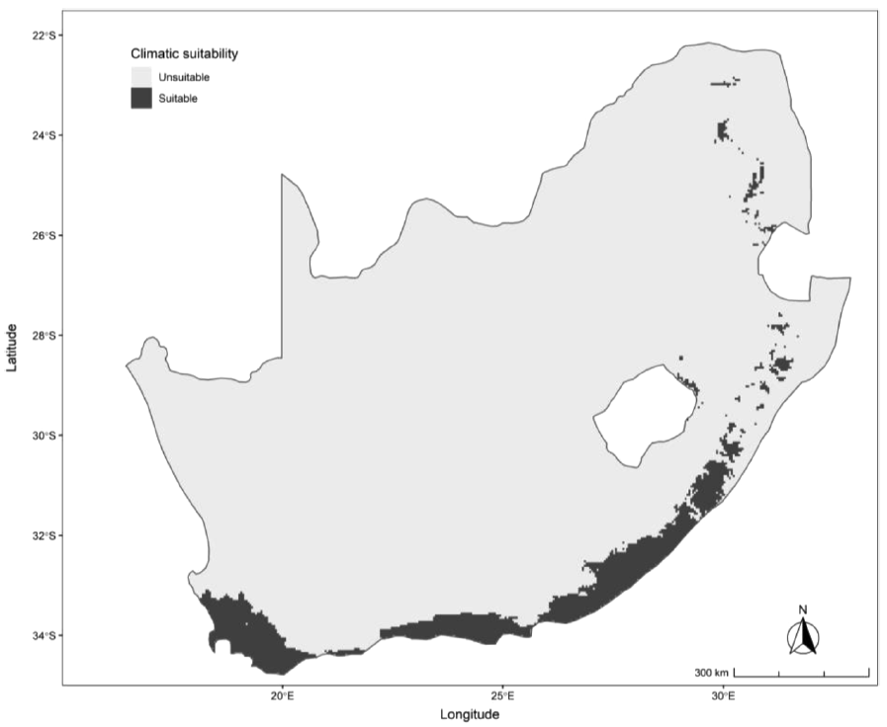
Sites with >75% probability of establishment

Slide 27
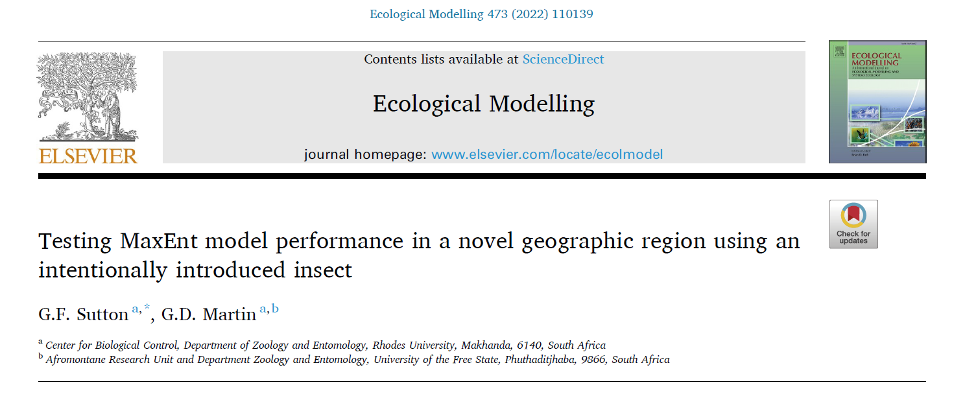
Summary
First validation of climate matching model in weed biocontrol
More studies are needed to rigorously validate climate models

Slide 28
SDM workflow
There are 10 key steps in fitting SDM’s:
1. Environmental data (e.g. climate)
2. GPS data
3. Background samples (pseudo-absences)
4. Multicollinearity / variable selection
5. Spatial autocorrelation
6. Data preparation
7. Model tuning
8. Model fitting
9. Model evaluation
10. Plotting model predictions

Slide 29
Lecture #1: Environmental layers
The crux of MaxEnt (and other SDM’s) is predicting potential species distributions based on some input variables
These inputs, or predictors, are usually restricted to climatic variables
For those familiar with GLM’s, MaxEnt works very similar to fitting a GLM like:
Species_presence ~ climate_variable1 + climate_variable2 + …

Slide 30
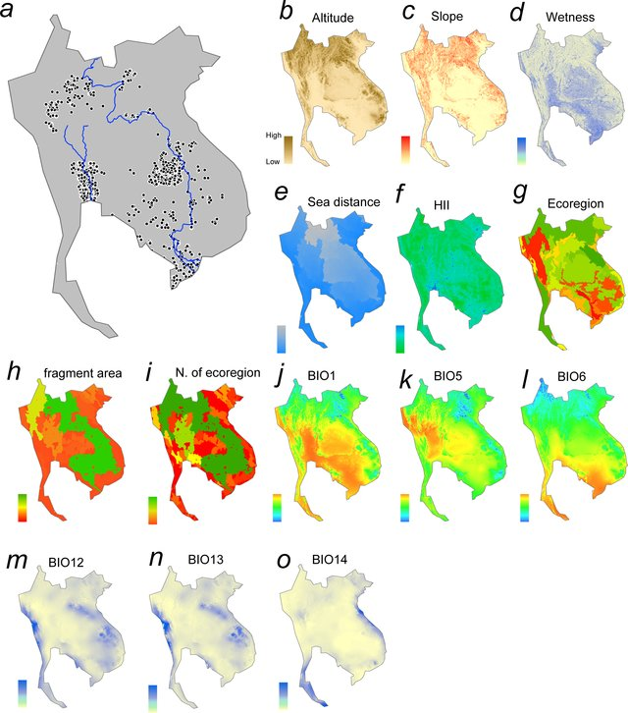
Types of layers
But, not restricted to just climate
E.g. Categorical variables (ecoregion), non-climate variables (distance-to-sea, hill slope...)
Kano et al., 2016 - 10.1371/journal.pone.0160151

Slide 31
Choosing layers
Typically, most SDM studies use a standard set of 19 bioclimatic variables
WORLDCLIM database
Represent annual/quarterly/monthly means of temperature and precipitation averaged over 1950-2000
Link: https://www.worldclim.org/data/bioclim.html

Slide 32
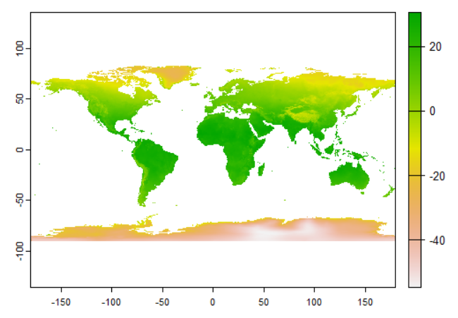
WORLDCLIM – Bio1
Bio1 = Mean annual temperature (Celsius)

Slide 33
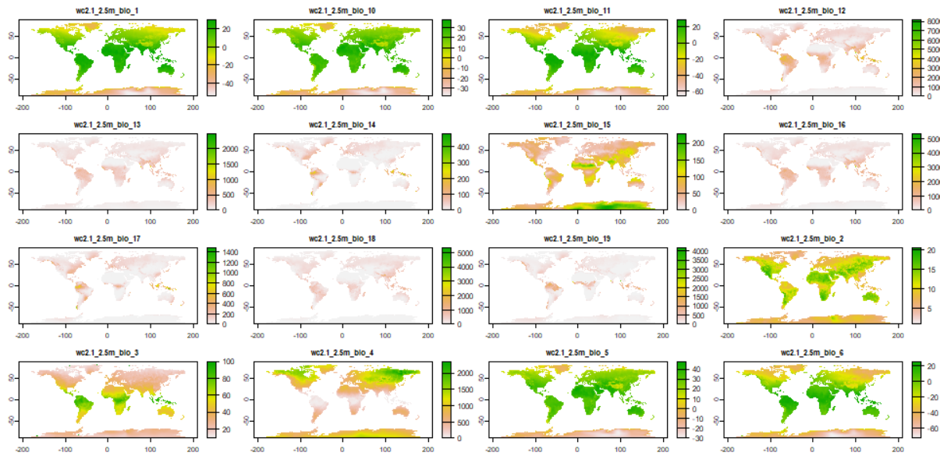
WORLDCLIM – All variables

Slide 34
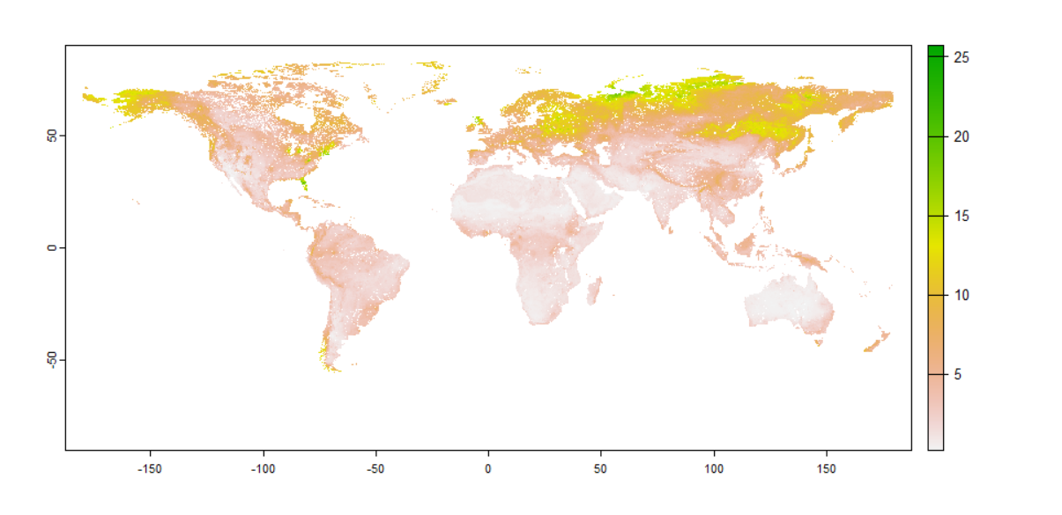
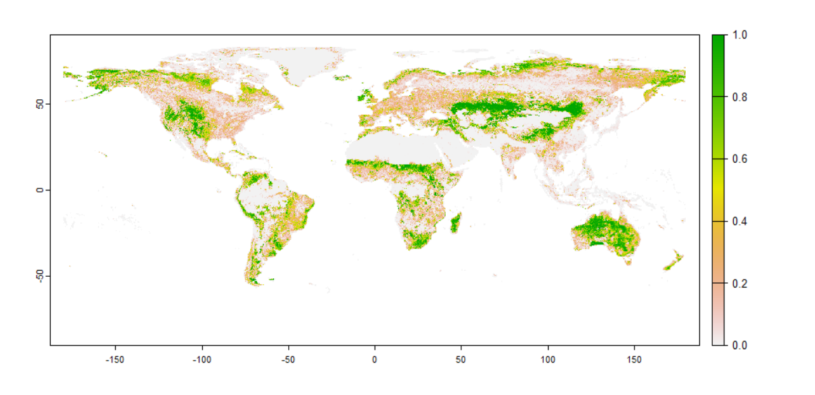
Other variables
We can basically input any information we want (easiest way is to have data stored in a raster/GIS layer)
Soil nitrogen concentration at 5cm depth
% grassland cover

Slide 35
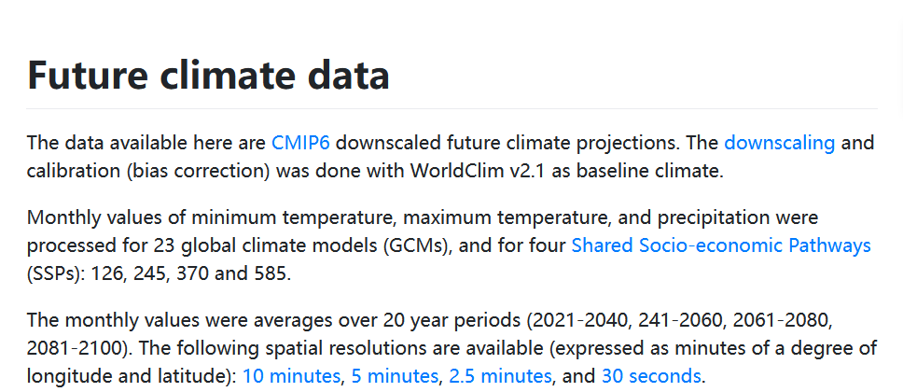
Future climates
Climate change forecasting

Slide 36
Selecting which variables
Typically, most SDM studies use a standard set of 19 bioclimatic variables
But, these models can perform poorly
Better to select variables based on knowledge of species biology/ecology
Particularly important for projecting models into novel geographic regions or time periods
What if we know nothing/little about species biology?
More on that later…

Slide 37
Downloading data
We can automate the downloading and importation of climate layers using `R`
In this session, we will
Download the full set of 19 WORDCLIM layers for the current time period
Download soil nitrogen concentration at 5cm depth
Down percentage grassland cover
Pre-process these raster layers to make them ready to be used by MaxEnt
Let’s go…

Slide 39
Lecture #3: Background points
SDM’s work by correlating the climate at species presence GPS points vs GPS points where the species is either absent or assumed to be absent (‘pseudo-absences’)
Absences and pseudo-absences represent very different data, right?

Slide 40
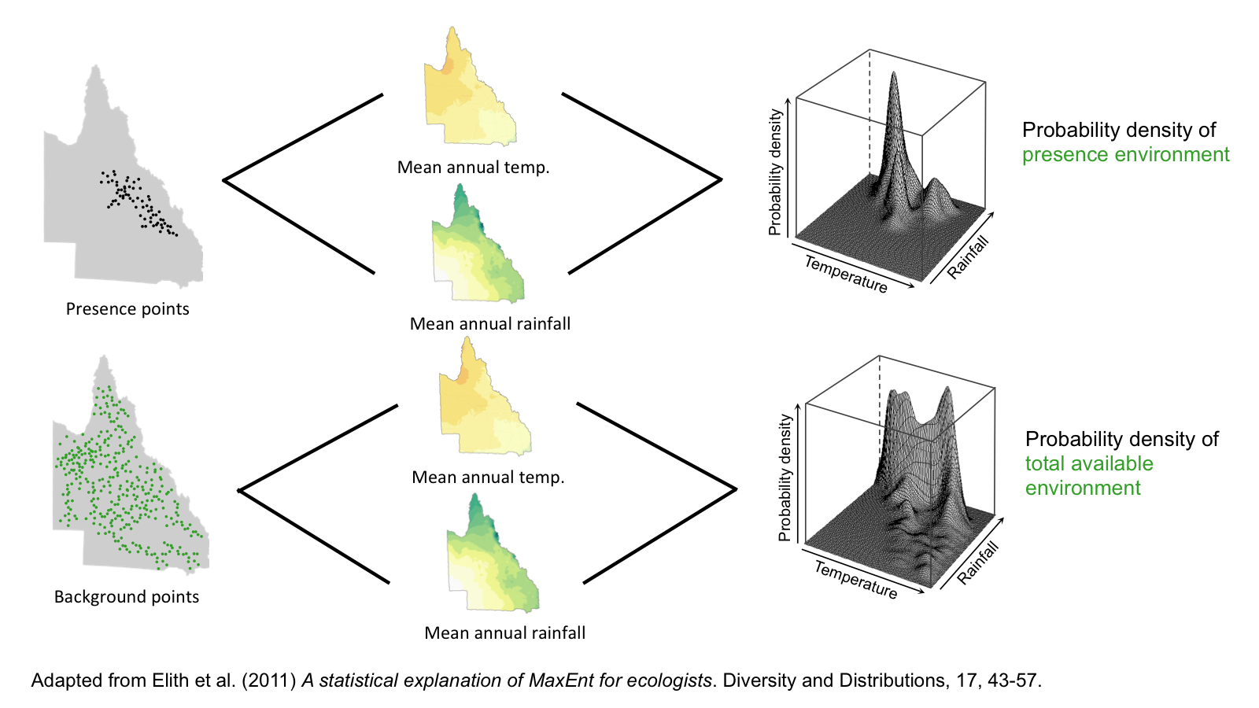
Background points and PDF
Elith et al., 2011 - https://doi.org/10.1111/j.2041-210X.2010.00036.x

Slide 41
Predicted presence
Most people interpret MaxEnt output as a probability of establishment or potential distribution
This is only valid when true absences are used, well sometimes (e.g. occupancy/detection)
When using pseudo-absences, MaxEnt output does not give you predicted distributions, but rather climatic similarity to training data

Slide 42
Selecting background points
Background points should be selected from an area that the species realistically could have reached (‘dispersal constraints’)
Too broad a background area = overconfident models

Slide 43
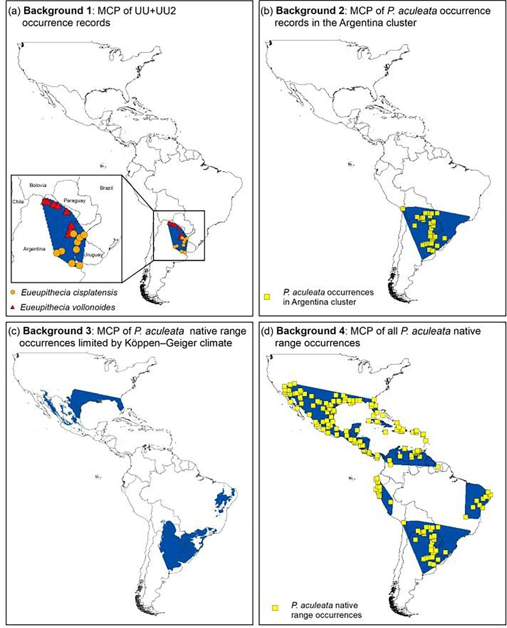
Background points
Minimum convex polygon (MCP)
Buffer (x km)
Koppen-Geiger
Targeted background (congeners)
Mukhurjee et al., 2021 - https://doi.org/10.1016/j.biocontrol.2021.104630

Slide 44
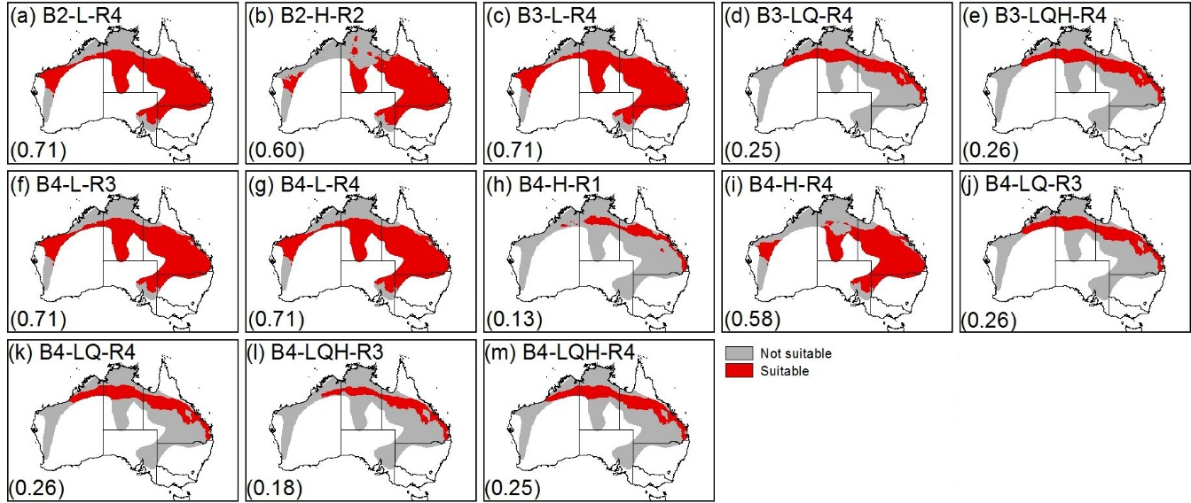
Variation in output
Mukhurjee et al., 2021 - https://doi.org/10.1016/j.biocontrol.2021.104630

Slide 45
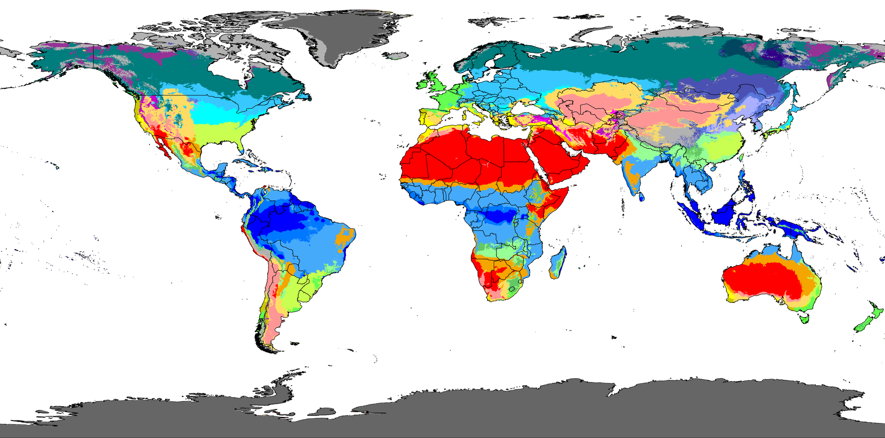
Selecting background points
Using the Koppen-Geiger layer is arguably the most appropriate method
Beck et al., 2018 – doi:10.1038/sdata.2018.214

Slide 46
Koppen-Geiger
Five major groups based on temperature and seasonal precipitation
Tropical
Temperate
Arid
Continental
Polar
Each group is broken up into many sub-groups

Slide 47
R and Koppen-Geiger
We can select our background area as only the KG regions containing at least 1 GPS presence point
Let’s go do this in R . . .

Slide 49
Lecture #5: Spatial autocorrelation
MaxEnt has become extremely popular, largely because of the availability of GPS data online (e.g. GBIF, iNaturalist)
Remember, MaxEnt is a presence-only technique:
Does not require confirmed absenses

Slide 50
Sampling bias
Key assumption is that the entire area of interest (fundamental niche) has been systematically sampled
Is that true for GBIF/Inat?
Usually, MaxEnt models are built-using heavily biases GPS data
Examples?

Slide 51
Spatial bias
Often significant spatial (and other) biases present in spatial datasets
Particularly for online repositories such as GBIF
Most records come from easily accessible areas (makes sampling easier)
E.g. Number of records correlate with distance to major cities/road networks/nature reserves

Slide 52
Environmental bias
Spatial biases usually translate into environmental biases (unknowingly to the user)
Overrepresentation of certain environmental characteristics from easily sampled geographic regions
This artificially separates the presence vs background points
The species could be present in other regions not sampled but included in the background area – problem!!!

Slide 53
Spatial autocorrelation
The spatial/environmental biases result in spatial autocorrelation
Autocorrelation of model errors (our model is systemically wrong)
Model accuracy is over inflated (too confident, transfers into other regions/times poorly)
Significance assigned to environmental predictors in the region studied, with little/no relationship with species presence

Slide 54
Yackulic et al. (2013) report that 87% of published studies on MaxEnt used spatially biased GPS data

Slide 55
Spatial filtering
To remedy this, we can use spatial filtering to limit the number of GPS points in oversampled geographic regions (Veloz, 2009).
In this session, we are going to use a correlogram to assess spatial biases in our data (plots correlations between climate variables at a range of distances between GPS points),
Thereafter, we will perform spatial filtering
Let’s go…

Slide 57
Lecture #6: Model tuning
Maxent can produce simple to very complex, nonlinear species–environment relationships (feature classes).
To reduce overfitting, Maxent uses a regularization procedure (L₁-regularization) to balance model fit with complexity, by penalizing models depending on the magnitude of their coefficients (regularisation multiplier)

Slide 58
Model settings and complexity
FC and RM settings determine how simple/complex is the model
Simpler models (e.g. with smoother functions) are found to perform better when projected into new geographic regions or time periods (as is NB in invasion science)
They don’t overfit the training data

Slide 59
Overfitting
Overfitting means the species-environment function is too complex
Overfitting is easy to identify as high performance in the training data but poor performance when projected into new regions or time periods
But, what if we can’t evaluate accuracy in the new region?

Slide 60
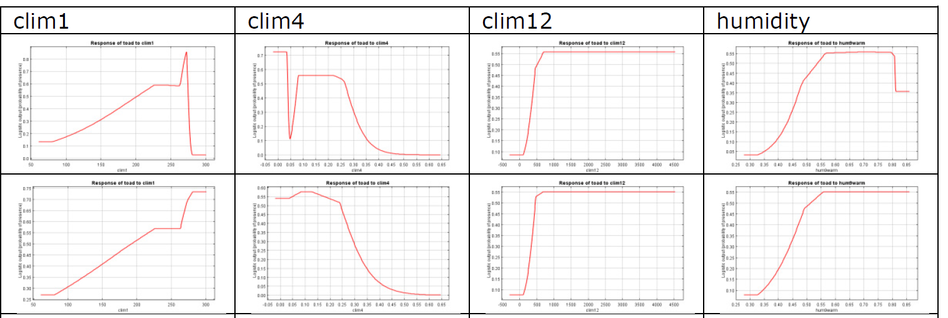
Overfitting
Elith et al., 2011 - https://doi.org/10.1111/j.2041-210X.2010.00036.x
We use FC and RM combinations to control the use (RM) and shape (FC) of these functions
Identity optimal settings to be as informative but simple as possible

Slide 61
Feature Classes (FC)
MaxEnt has 6 feature class (FC) options that it uses to model the relationship between species presence/absence and predictor variables
By default, it uses all FC options (depending on sample size), but nowadays, we should be calculating optimal settings on a case-by-case basis
Simpler models (with fewer and simpler FC classes) are often better than default FC settings

Slide 62
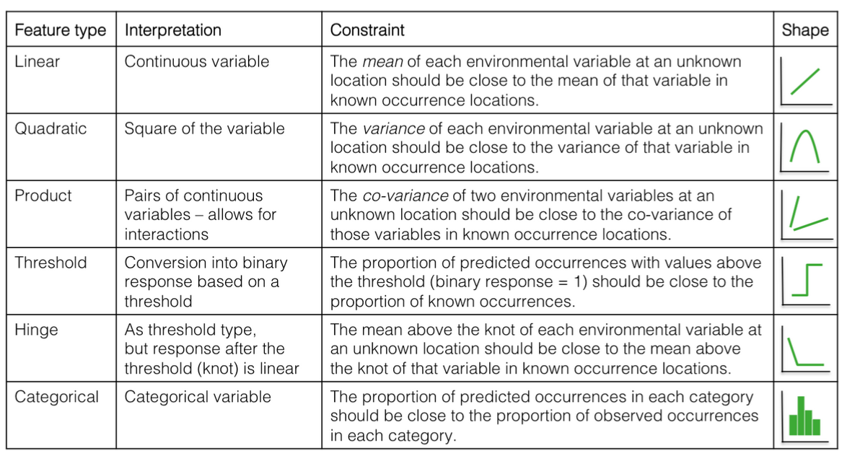
Six FC options

